Slide 1


DATABASE FOUNDATIONS
PROJECT
INSIDE AIRBNB - USA (NEW JERSEY)
Group: 13
Presented By:
Rikin Patel (rxp220105)
Rucheek Rajeev Kashyap (rxk230010)
Krishna Chaithanya (kxk230041)
Guided By:
Prof. Thiru Pandian

Slide 2

CONTENTS
01
BUSINESS OBJECTIVE
02
PROBLEM STATEMENT
03
LOGICAL DIAGRAM
04
CONCENTUAL DIAGRAM
05
PROJECT INSIGHTS
06
VISUALIZATIONS
07
CONCLUSION

Slide 3





INTRO - BUSINESS OBJECTIVES
Objective 1
Objective 2
Objective 3
Maximize efficiency
Optimizing property type distribution
Providing insights to property managers
Improve guest satisfaction
Evaluate the impact of premium features

Slide 4



PROBLEM STATEMENTS
Host Performance Recognition
Guest Satisfaction Monitoring
Marketing Effectiveness
Property Diversification
Optimizing Business Strategies
Financial Decision Support

Slide 5

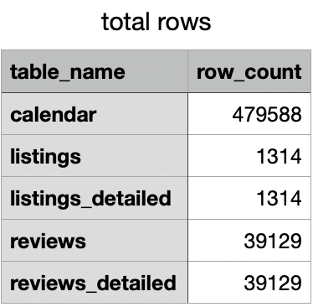
ABOUT THE DATASET
listings detailed.csv: Detailed Listings data
calendar.csv: Detailed Calendar Data
reviews detailed.csv: Detailed Review Data
listings.csv: Summary information and metrics for listings
reviews.csv: Summary Review data and Listing ID

Slide 6
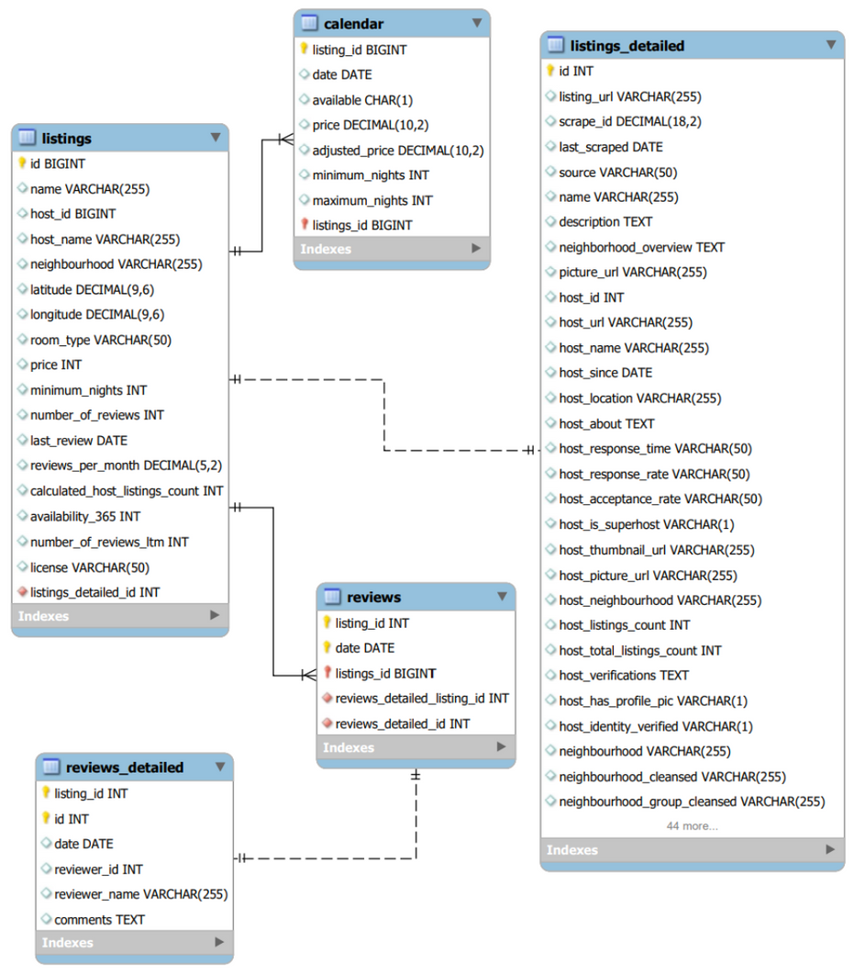
LOGICAL DIAGRAM

Slide 7
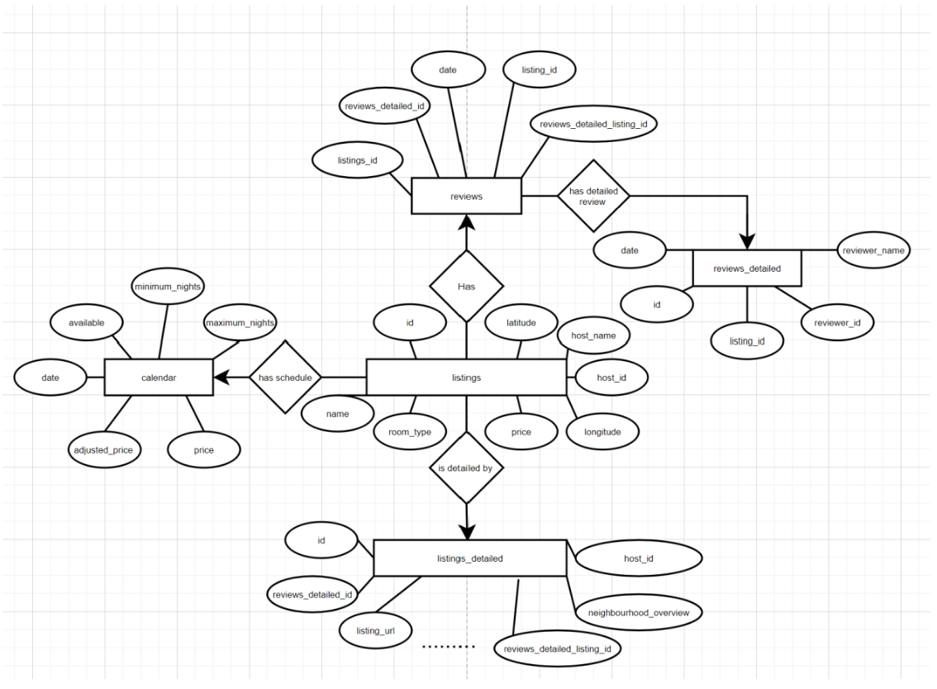
CONCEPTUAL DIAGRAM

Slide 8
PROJECT INSIGHTS
Valuable insights ranging from host performance metrics to optimal pricing strategies.

Slide 9
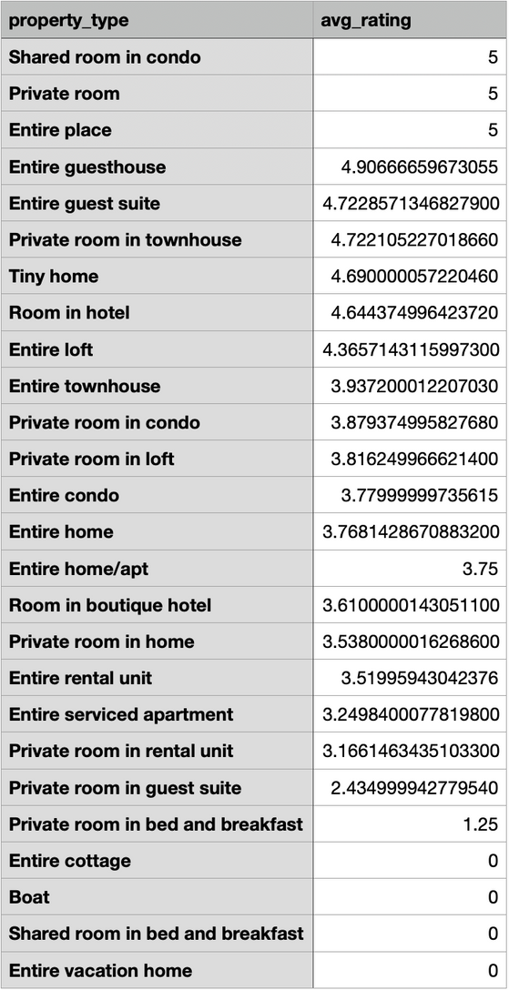
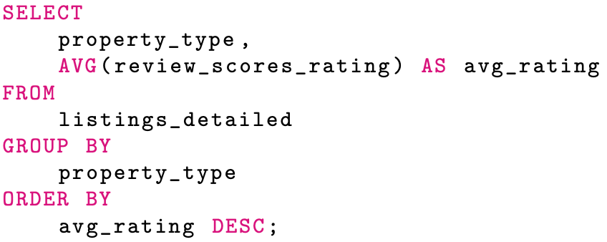
AVERAGE REVIEW SCORES BY PROPERTY TYPE
Actions:
Enhance Low-Rated Property Types
Promote Diverse Options

Slide 10
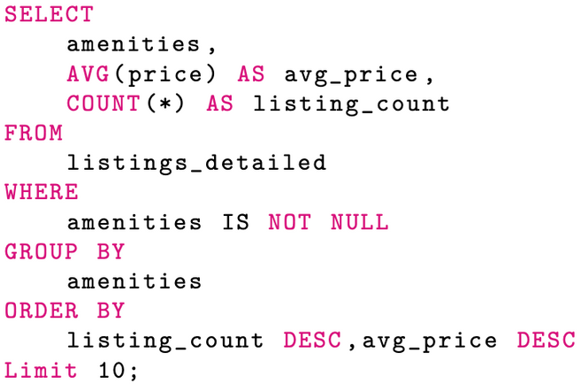
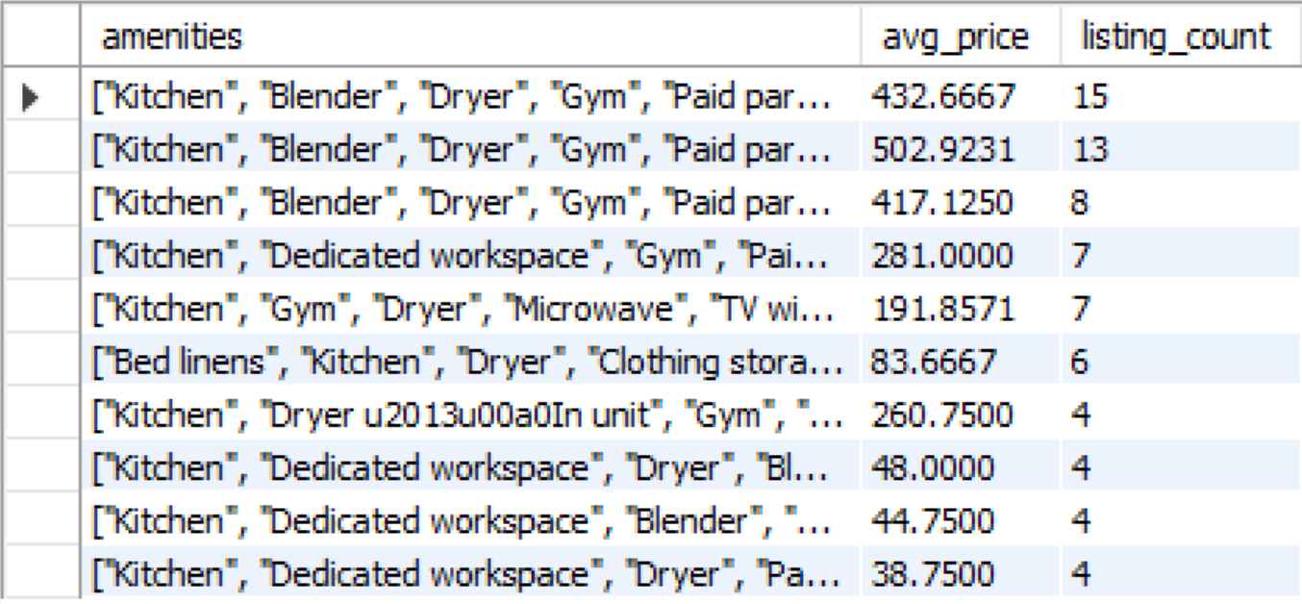
DATA TO GATHER TO ROLLOUT PREMIUM FEATURES
Actions:
Highlight Premium Amenities
Explore Amenity Combinations
Optimize Pricing Strategy

Slide 11
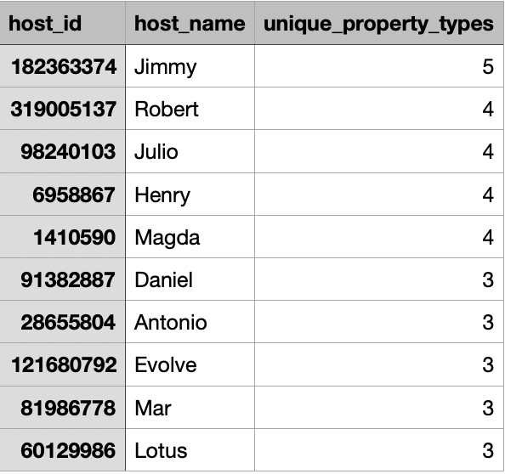
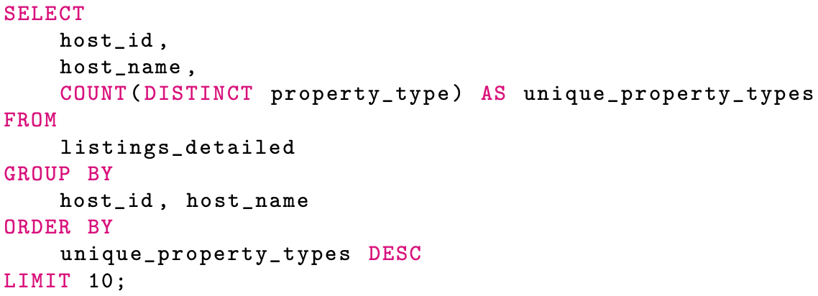
HOSTS OFFERING THE MOST VARIED PROPERTY TYPES
Actions:
Recognition and Collaboration
Promotion Strategies
Support for Expansion

Slide 12
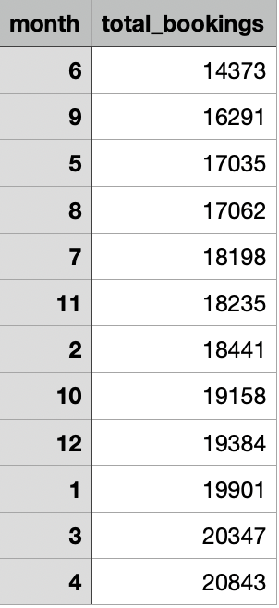
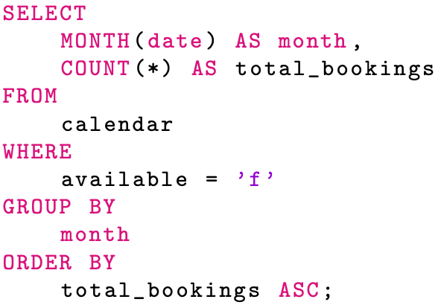
DURING WHICH MONTHS ARE LISTINGS THE LEAST BUSY?
Actions:
Seasonal Marketing Strategies
Resource Optimization
Dynamic Pricing

Slide 13
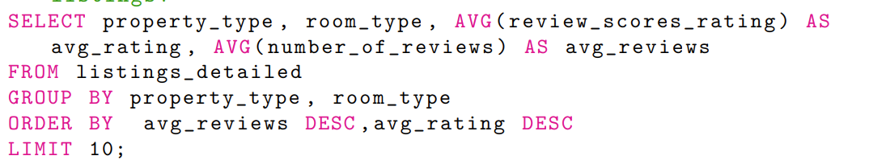
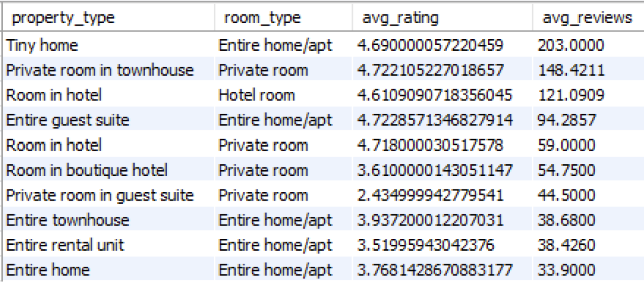
FACTORS PREDICTING THE HIGHEST PERFORMING LISTINGS
Actions:
Enhance Top Categories
Customer Satisfaction Initiatives
Targeted Marketing

Slide 14
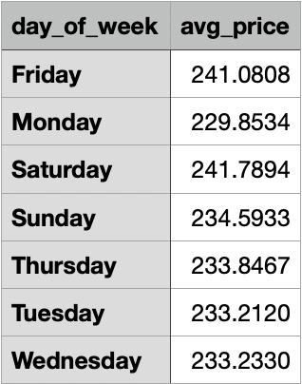
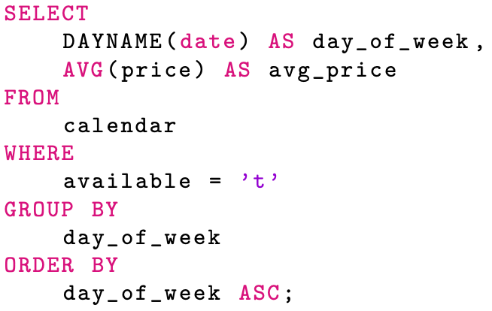
THE PRICE DIFFERENCE BETWEEN WEEKENDS AND WEEKDAYS
Actions:
Weekend Specials
Dynamic Pricing Adjustments
Marketing Emphasis

Slide 15
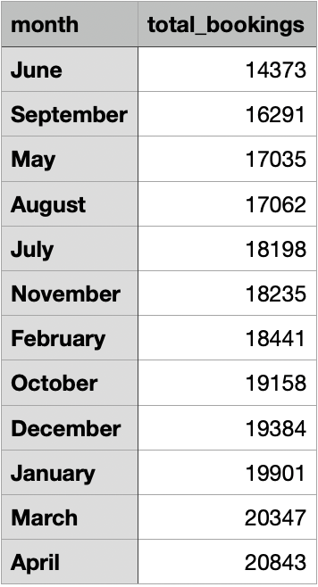
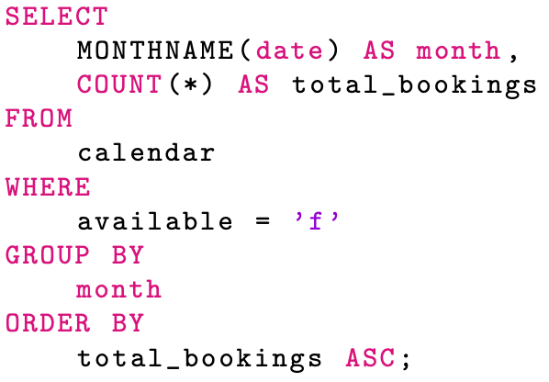
SEASONAL DEMAND VARY THROUGHOUT THE YEAR
Actions:
Seasonal Promotion
Resource Allocation
Data-Driven Marketing

Slide 16
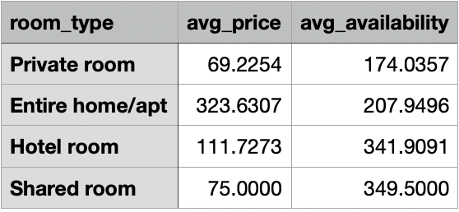
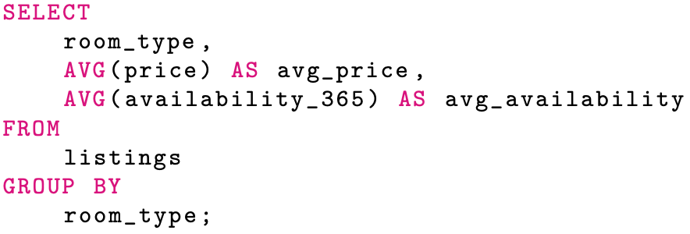
OPTIMAL PRICING STRATEGY FOR DIFFERENT ROOM TYPES
Actions:
Competitive Pricing
Value-Added Services
Dynamic Pricing Algorithms

Slide 17
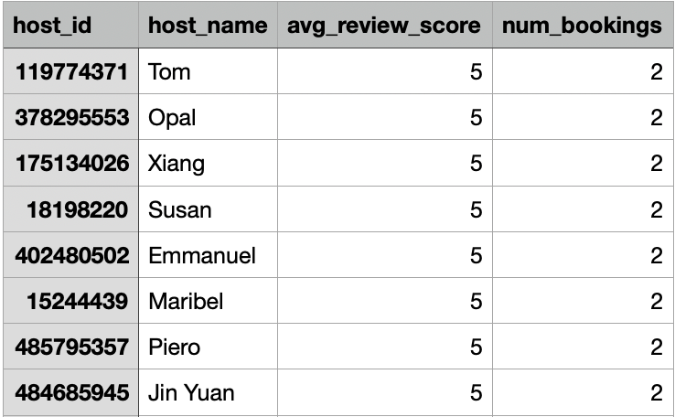
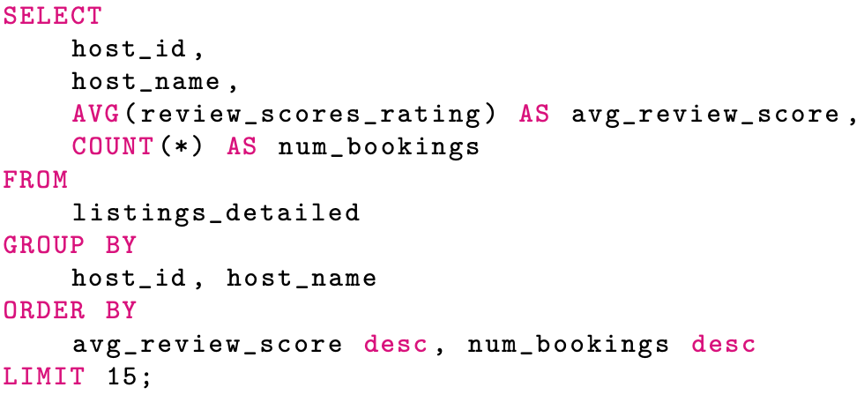
HOSTS PERFORMANCE IN TERMS OF REVIEWS AND NUMBER OF BOOKINGS
Actions:
Incentive Programs
Feature Top Hosts
Host Training

Slide 18
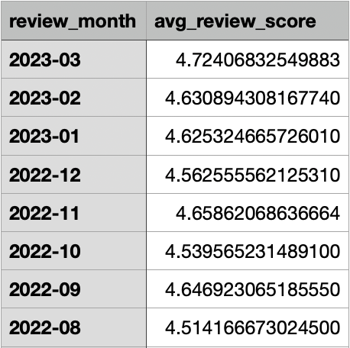
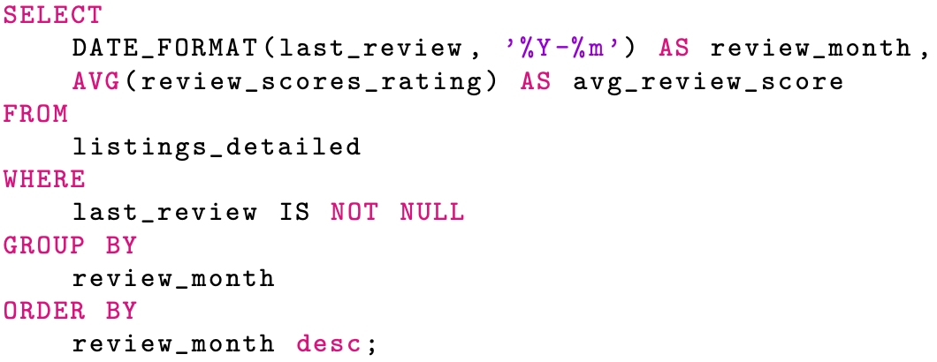
GUEST SATISFACTION TRENDS CHANGING OVER TIME
Actions:
Quality Improvement Initiatives
Communication Channels
Celebrating Success

Slide 19
VISUALIZATIONS

Slide 20
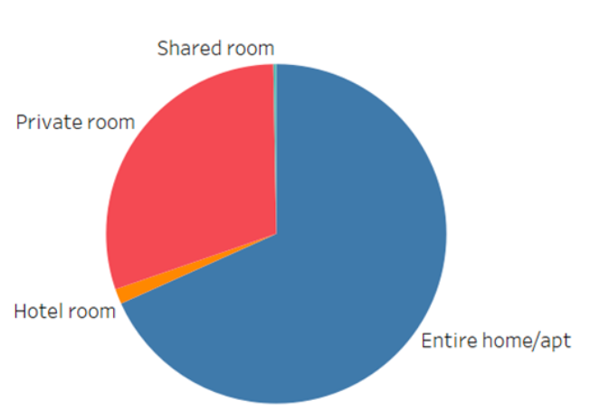
NUMBER OF ROOMS AVAILABILITY FOR 365 DAYS BY ROOM TYPE
The entire home/apartment type consistently exhibits the highest availability, followed by private rooms.

Slide 21
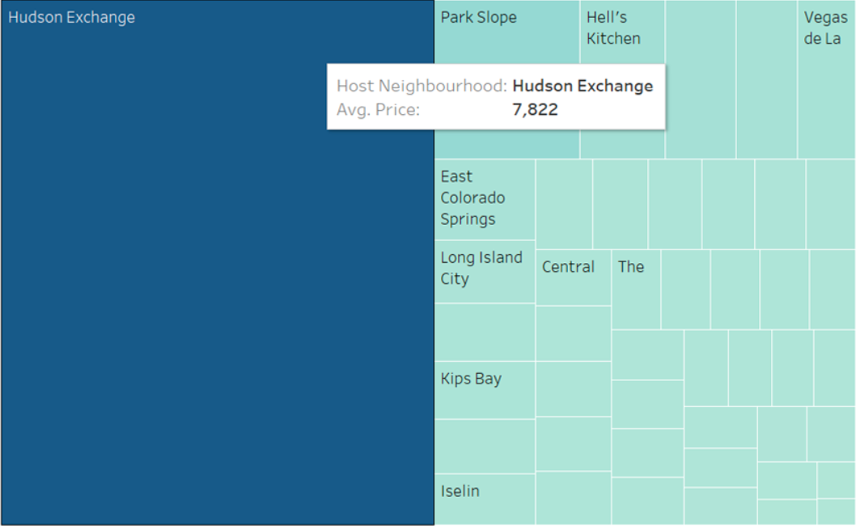
AVERAGE PRICES OF HOST NEIGHBOURHOODS
Hudson Exchange stands out with the highest average price of $7822, suggesting a potentially premium service.

Slide 22
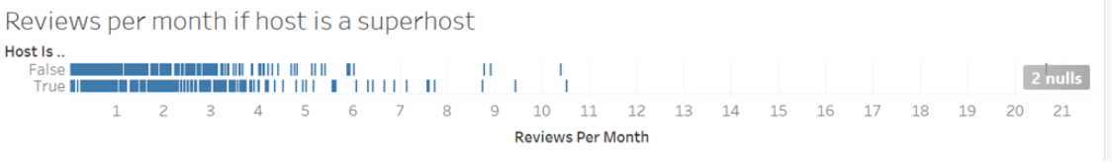
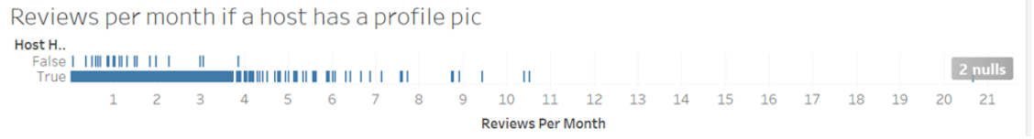
REVIEWS PER MONTH IF HOST IS A SUPERHOST VS IF HOST HAS A PROFILE PIC
Being a superhost doesn’t significantly impact the number of reviews.
However, hosts without profile pictures receive fewer reviews

Slide 23
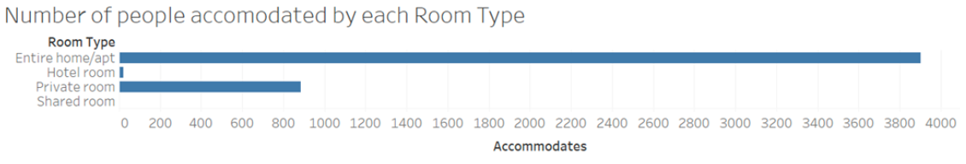
NUMBER OF PEOPLE ACCOMMODATED BY EACH ROOM TYPE
Entire home/apartment types consistently accommodate the highest number of people
Shared rooms accommodate the least.

Slide 24
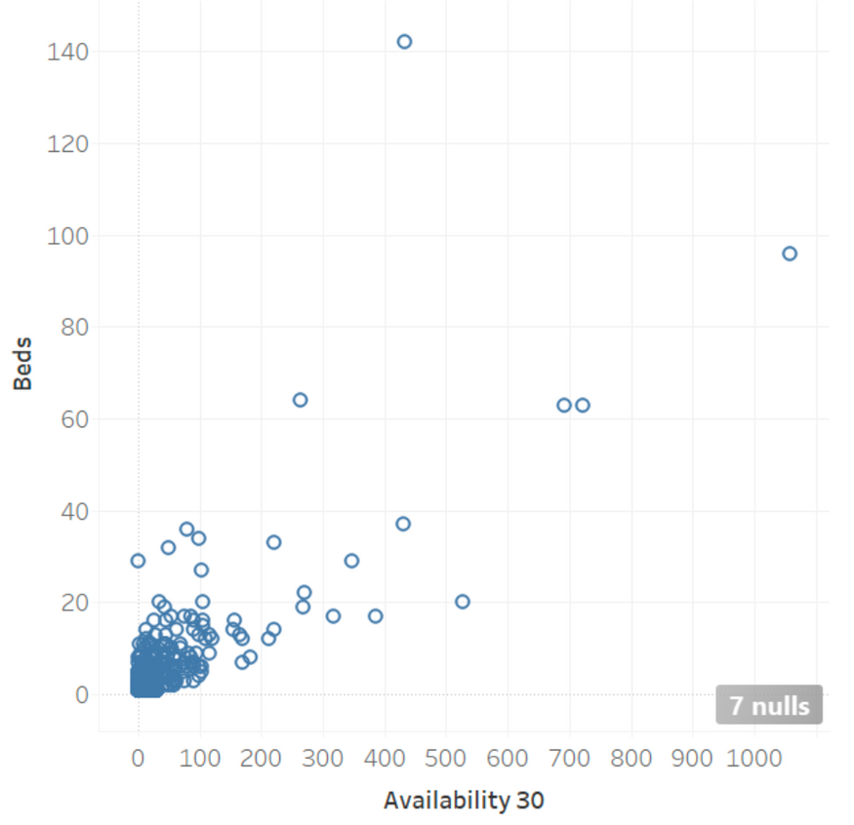
NUMBER OF BEDS AVAILABLE IN 30 DAYS BY HOSTS
No. of Beds vs 30 days availability by hosts

Slide 25

CONCLUSION
Some of the key observations include:
Assessed hosts’ performance
and Tracked guest satisfaction trends over time
Explored the diversity among hosts, highlighting opportunities for further property type dis- tribution.
Analyzed the impact of premium features on pricing and listings, aligning product offerings with customer preferences.
Uncovered the busiest months for listings, shedding light on seasonal demand patterns
3
1
4
2

Slide 26


Actions and Recommendations:
01
02
03
04
05
STRATEGIC DECISION-MAKING
MARKETING OPTIMIZATION
OPERATIONS AND PRICING OPTIMIZATION
HOST ENGAGEMENT
INNOVATION AND PRODUCT DEVELOPMENT
Executive leadership can leverage insights for strategic decision-making
Refining their strategies, tailoring campaigns based on seasonal demand and booking trends.
Identify and reward high-performing hosts, foster-
ing positive partnerships.
Optimize property type distribution and pricing strategies for enhanced efficiency.
Align premium feature rollouts with customer
preferences, driving innovation on the platform.

Slide 27

THANK YOU

